Slide 1



树德书院互助课堂
计算机程序设计基础
——易翔

Slide 2

练习
Determine whether each statement is true(T) or false(F) in Java according to its correctness.
The char type of charactors are implemented in 16 bits from '\u0000' to '\uFFFF'.
Single-floating-point number type float is implemented with 48 bits.

Slide 3
练习
Determine whether each statement is true(T) or false(F) in Java according to its correctness.
The char type of charactors are implemented in 16 bits from '\u0000' to '\uFFFF'. (T)
Single-floating-point number type float is implemented with 48 bits.(F)
float is implemented with 4 bytes, which is equivalent to 4 * 8 = 32 bits.

Slide 4
运算符
+-*/ 四则运算
+=，-=，*=，/= 扩展
||，&& 逻辑运算
|，& 位运算
~,^ 位运算 (int)Math.pow(a, b);
++， -- 自增、自减

Slide 5
一个问题
int m = 7;
int n = 7;
int a = 2 * ++ m;
int b = 2 * n ++;
运行如上的代码，在第四行运行结束后a，b，m，n的值分别为多少？

Slide 6
位运算
“a^b”不是表示a的b此方！
>> 和 >>> 的区别？
5>>1;

Slide 7
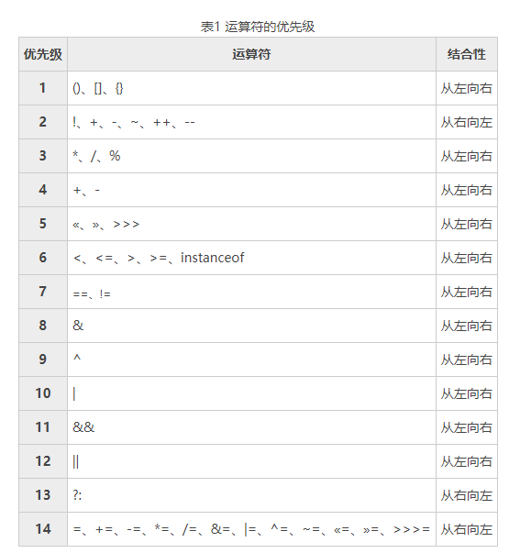
优先级

Slide 8
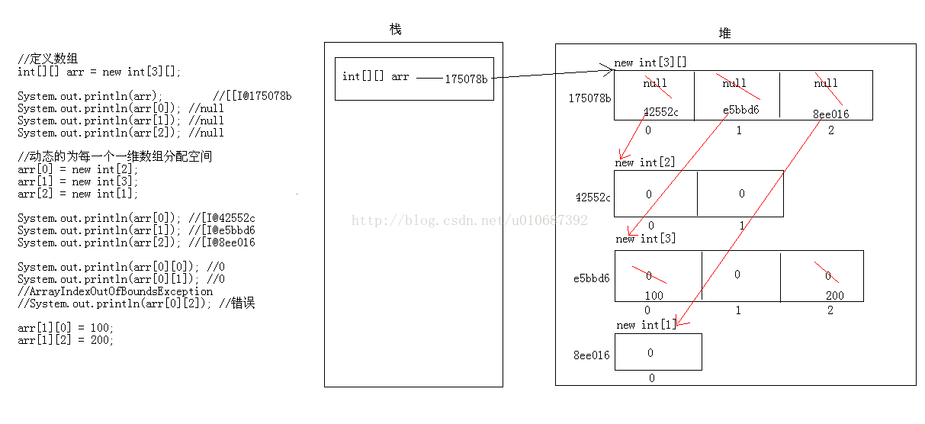
多维数组
二维
数组

Slide 9
初始化
int[][] array = new int[][]; (Incorrect)
int[][] array = new int[3][]; (Correct)
int[][] array = new int[][3]; (Incorrect)
Enumerate each element (Correct)

Slide 10
Enhance for
int[][] t = new int[n][n];
for (int[] array : t) {
for(int i : t) {
\\ Do something
}
}
Two layers of nested loop statements are required!

Slide 11
面对对象
object-oriented programming OOP

Slide 12
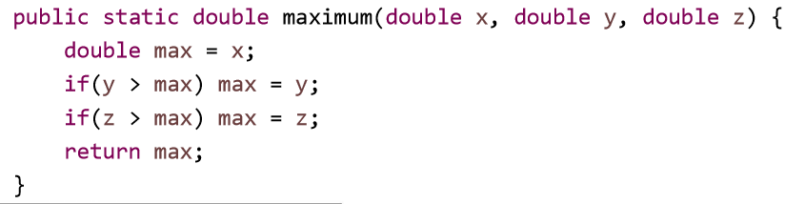
方法

Slide 13
值传递的性质

Slide 14
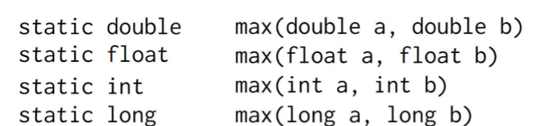
方法重载

Slide 15
Thanks For Watching！

